Slide 1
CAREER COUNSELLING SOFTWARE
QUESTRITE
ORGANISATION NAME: GOVERNMENT OF UTTARAKHAND
PROBLEM STATEMENT_ID: MK106
TEAM DETAILS: BRANIACS_1.0
SHIKHA KUMARI PATHAK (GROUP LEADER)
TANIYA GHOSH
GAYATRI JENA
PRATYUSH PANI
AKASH MISHRA
SHANTANU BHRIGUVANSHI
1

Slide 2
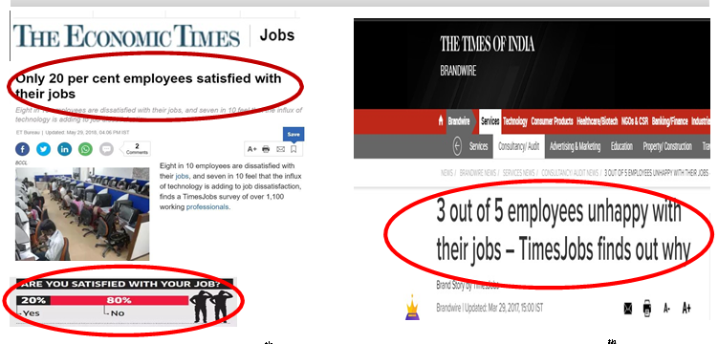
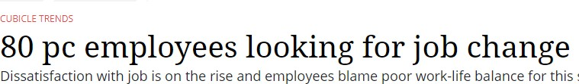
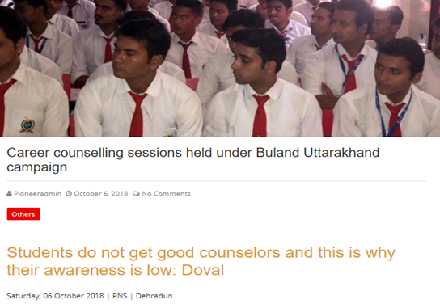
MOTIVATION BEHIND THE IDEA
In India, 3 out of 5 employees are unhappy with their jobs
80% of the employees are looking for job change
Only 20% of the employees are satisfied with their jobs
Moreover in Uttarakhand, students do not get good counsellors and the awareness is low.
Though some career counselling sessions are held in
Uttarakhand, it is not available to the masses.
**Source1: THE ECONOMICS TIMES, 29th May 2018
**Source2: THE TIMES OF INDIA, 29 Mar 2017
**Source3: THE PIONEER, 6th OCTOBER 2018

Slide 3
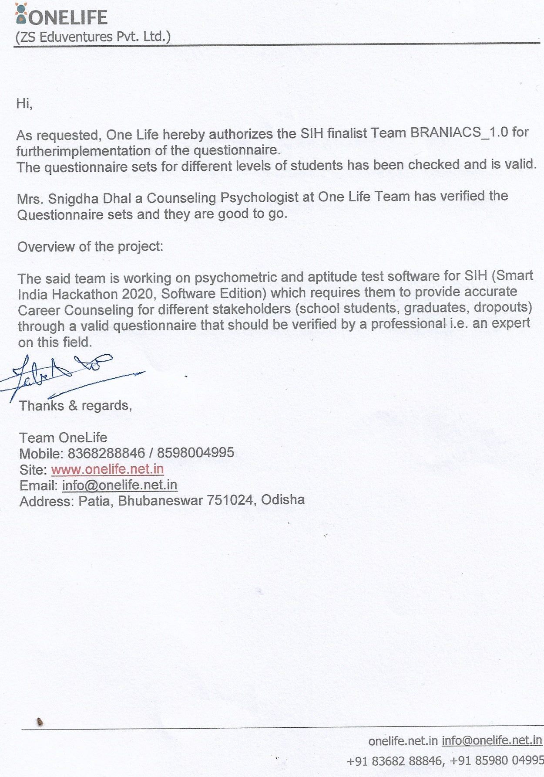
PROPOSED APPROACH
We devised a model for school students , dropouts, graduates to identify different features of a student’s personality
Analyse these features to find the personality domain of the student
Verify the questionnaire by a psychometric analyst
A personality and aptitude test is to be conducted
And finally to use this model to help students find their right career path applying the above hypothesis
FOR THE EFFICACY OF THE MODEL AND TO MAKE THE MODEL FAULT TOLERANT, WE HAVE OUR QUESTIONNAIRE VERIFIED BY A PSYCHOMETRIC ANALYST.

Slide 4
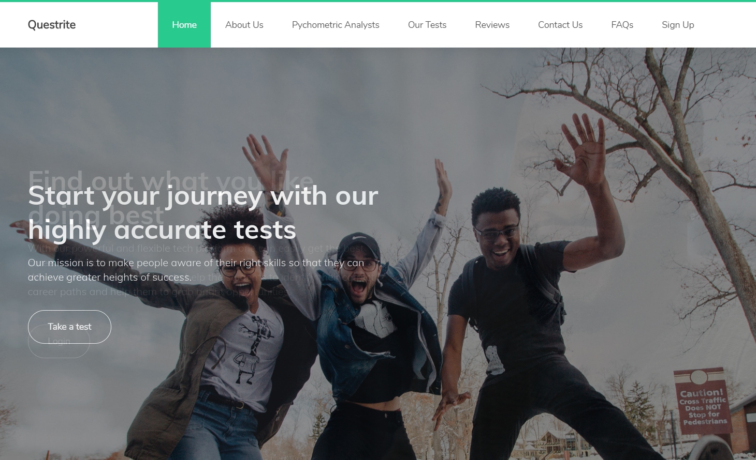
OUR USER INTERFACE
HOME
Contains various features and the zest of the model
ABOUT US
It says a lot about our Mission, Vision and our beliefs towards the right choice of career
PSYCHOMETRIC ANALYST
Questionnaires refined and verified by Mr. Summon Patra (CEO) and Miss Snigdha Dhal (Counselling Psychologist) of One Life Corporation
OUR TEST
All of our tests are heavily based on Holland’s RIASEC Theory
REVIEWS
People working on different fields and having different interests have taken our test and their positive feedbacks helped us in efficacy of the model
CONTACT US
Send us and email with a message and we shall contact you as soon as possible
FAQS
As per as some tests we have conducted to get a dataset, we have answered all and every possible query, asked to us during testing and displayed them for the users
LIST OF COLLEGES
We provide the list of best colleges according the career field output

Slide 5





PROJECT FLOW
Sign Up: As a new user
Matriculation
User
Secured Login
Select Current Status
Already an user
Graduates
START TEST
Dropouts
FRONTEND
New Register: Data gets stored
in tabular form Login: Entered data is again matched with stored data
If “Login == New Register”,
then secured login is successful
Questionnaire
(Verified by Psychometric Analyst)
Research papers & Holland’s Code
BACKEND
Data Storage: Data stored when the user gives the test
Result: Best possible career option based on answers given
Aptitude Test Conducted
Career Field Display
Personality Test Conducted
Personality/Aptitude domain display

Slide 6
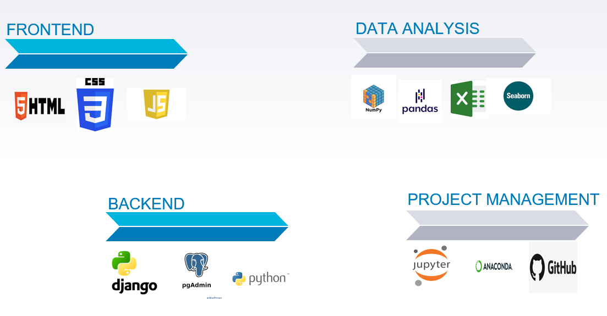
METHOD TABLE & TECHNOLOGY STACK
Categories | Career Opportunities | Aptitude
Realistic | engineers, architecture, dietitian, criminal justice, forestry and athlete. | spatial, temporal reasoning
Investigative | biology, chemistry, computer science, economics, law, math, psychology and data analyst. | quantitative aptitude
Artistic | advertising, art, graphic design, music, theater and writer. | verbal aptitude
Social | communications, anthropology, education, nursing, religion, sociology and social work. | interpersonal competencies, skill in mentoring, treating, healing, or teaching others(situational)
Enterprising | business, finance, law enforcement, real estate, marketing and journalism. | skills in persuasion or manipulation of others.(situational)
Conventional | accounting, computer information system, library science and administrative work. | data manipulation, perceptual speed and numerical computation.

Slide 7
DEPENDENCIES & ADVANTAGES
On-boarding user on application
Applicants profile created beforehand
Basic degree required:- Matriculation
Information
Applicants must provide their current educational status
Infrastructure
Applicants should have the basic IT infrastructure to run the web application
To make our software available to regional students in their regional language
To provide courses according to the career obtained
To provide list of colleges which would be best for their career field
To provide mentoring sessions after career obtained

Slide 8
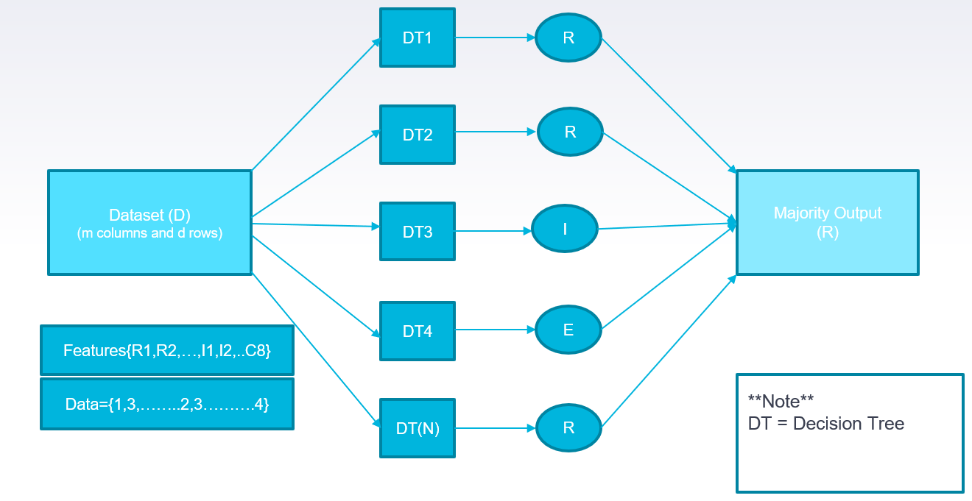
IDEA OF OUR ML MODEL

Slide 9
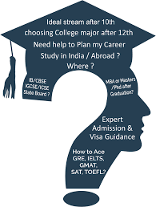
CONCLUSION
Major youth population in our country is unaware of the importance of choosing the best career path. Taking Indian education system into consideration we have designed this career counselling software so, that the youth knows what’s best for their career.
Most of the Indian parents do not believe in the career counselling system, for which the students do not come up for the career counselling sessions. Hence, our team is trying to reach those students in need through this career counselling software.
WE BELIEVE IN MAKING A CHANGE!

Slide 10
THANKS!

